Slide 1

Progress on ITER remote experimentation Center
The 10th IAEA-TM on Control, Data Acquisition,
and Remote Participation for Fusion Research
April 20-24, 2015, Ahmedabad, Gujarat, India
Presented by H.Nakanishi³⁾
T.Ozeki¹⁾, S. C. Lorenzo²⁾, N.Nakajima³⁾
¹⁾ Japan Atomic Energy Agency,
²⁾ Fusion for Energy
³⁾ National institute for Fusion Science
1
Notes:
Thank you chairman.
I would like to present “Progress on ITER remote experimentation Center”.

Slide 2
Members of the REC activities
IFERC and STP projects
Noriyoshi NAKAJIMA (IFERC PL, NIFS), Shirai HIROSHI (STP PL, JAEA)
Susana CLEMENT-LORENZO (F4E), Gianmaria DE TOMMASI (F4E), Jonathan FARTHING (F4E-expert, Culham/JET), Gerardo GIRUZZI (EUROfusion), Emmanuel JOFFRIN (EUROfusion), Gabriele MANDUCHI (F4E-expert, Consorzio RFX), Filippo SARTORI (F4E), Francois ROBIN (CEA)
Nobuhiko HAYASHI (JAEA), Shunsuke IDE (JAEA), Yasutomo ISHII (JAEA), Hirotaka KUBO (JAEA), Makoto MATSUKAWA (JAEA), Osamu NAITO (JAEA), Hideya NAKANISHI(NIFS), Shigeru OHIRA (JAEA), Takayuki OSHIMA (JAEA), Takahisa OZEKI (JAEA), Shinya SAKATA (JAEA), Toshiyuki TOTSUKA (JAEA), Hajime URANO (JAEA), Kenjiro YAMANAKA (NII)
Notes:
This activities is carried out by the project leader of IFERC project with the collaboration to the satellite tokamak project.
And implementation agencies and experts of both side of EU and Japan.

Slide 3
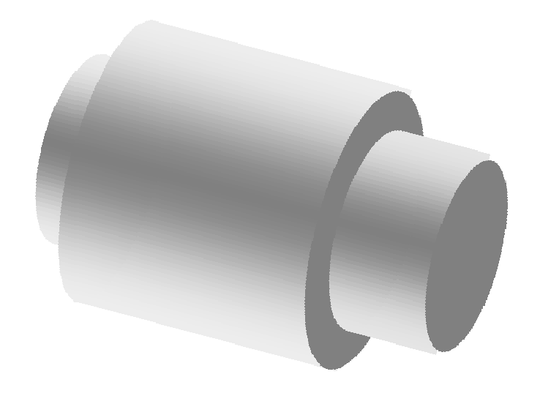
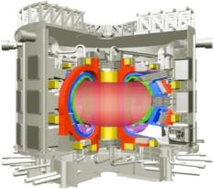



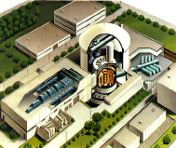


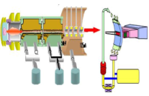
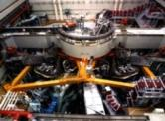
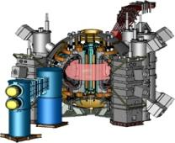
Broader Approach Activities
Broader Approach Activities is the joint implementation based on the agreement between the Government of Japan and the
EURATOM for support of ITER project and an early realization of fusion energy.
DEMO
Demonstration of Fusion Power Plant
ITER : Demonstration of Scientific
and Technological Feasibility
of Fusion Energy
Taking Initiative of Fusion Research
Development of Fundamental Fusion Technology
(3) Human Resource Development
Broader Approach Activities
Q =10
DT Burning 300-500s
Rokkasho, Aomori
IFERC
IFMIF/EVEDA
JT-60
Fusion Technology
Naka, Ibaraki
Q = 1.25
Ti(0) = 45keV
Material
Blanket
R&D (Coils, VV, Heating)
Satellite Tokamak
3
Notes:
ITER remote experimentation center is carried out as one of Broader Approach Activities.
Broader Approach Activities is the joint implementation based on the agreement between the Government of Japan and the
European Atomic Energy for support of ITER project and an early realization of fusion energy.
Broader Approach activities comprise three project.
Projects of IFERC and IFMIF/EVEDA are carried out in Rokkasho, Aomori.
And Satellite tokamak project is carried out in Naka, Ibaraki.
(next page)

Slide 4



Broader Approach Activities comprise
three projects
1) Engineering Validation and Engineering Design
Activities for the International Fusion Materials
Irradiation Facility (IFMIF/EVEDA:2007-2017)
2) International Fusion Energy Research Centre
(IFERC: 2007-2017), project leader is N.Nakajima
a) DEMO Design and R&D coordination Centre
b) Computational Simulation Centre
c) ITER Remote Experimentation Centre
3) Satellite Tokamak Programme (2007-2019)
Participation to upgrade of JT-60 Tokamak to JT-60SA and its exploitation.
4
Notes:
International Fusion Energy Research Centre, IFERC, project is consists of three activities:
that are a) DEMO Design and R&D, b) Computational Simulation Centre, c) ITER Remote Experimentation Centre.
This project started in 2007. The DEMO Design and R&D, and Computational Simulation Centre are going on.
The .12PBite super computer has been operated for the simulation in fusion area.
Recently activity of Remote experimentation centre started.

Slide 5

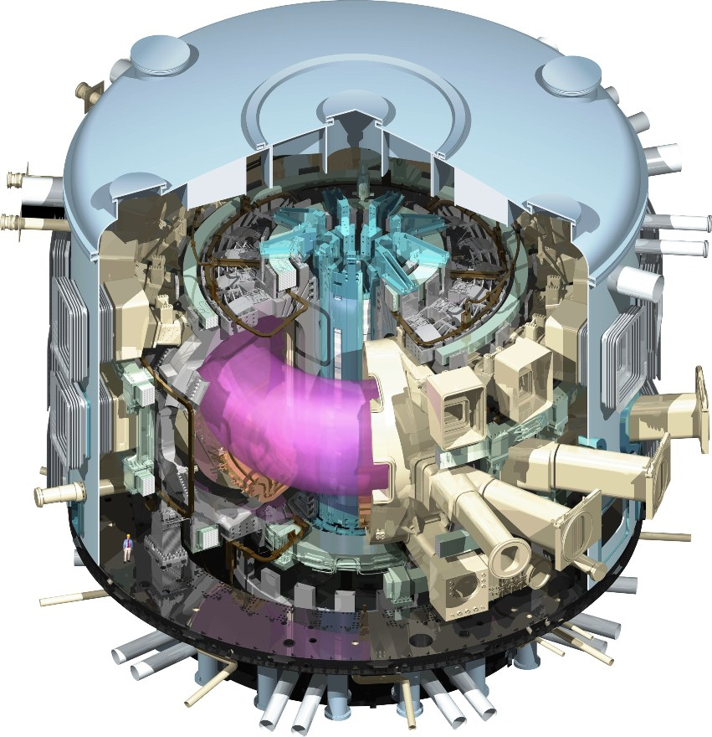
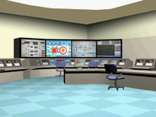
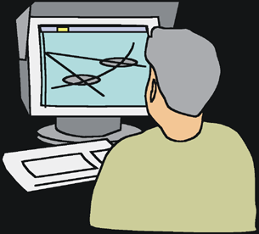


ITER Remote Experimentation Centre (REC)
The ITER remote experimentation centre will be made to participate the experiment remotely, where the experimental proposal and data collection and analyses will be done through the broad band network.
ITER Organization
(Saint-Paul-les-Durance)
ITER Remote Experimentation Centre (Rokkasho, Japan)
Validation of safety of the facility and Operation
Broad band internet
//
Monitor of the operation,
Transfer results of experiment
Data collection and analyses
Data storage and Analyses
Send discharge parameter
Setting discharge parameter
Proposal and setting discharge parameter by remote user
5
Notes:
The ITER remote experimentation centre (REC) will be made to participate the experiment remotely, where the experimental proposal and data collection and analyses will be done through the broad band network.
In the remote experiment center, build in Rokkasho, Japan,
the remote user will propose and set the discharge parameter.
The discharge parameter will be sent to the on-site facility of ITER, and the experiment will be executed after the validation of this discharge parameter.
After the execution of the experiment, the experiment data will be sent to the remote site and the data were stored and analyzed.
5

Slide 6
Activities up to now
Overall plan of REC was created by Preparatory Working Group （PWG）that is consisted of EU and JA experts, chaired by N.Nakajima of IFERC project leader.
The overall plan describes objectives, scope, schedule, etc. , and it was approved in the broader approach steering committee in 2012.
The contents of the overall plan was presented in the last meeting, 9th IAEA TM on Control, Data Acquisition, and Remote Participation for Fusion Research, held in ASIPP, Hefei, China in 2013.
Objectives of REC activities written in the overall plan
  Identify the functions and solve the technical issues for the construction of the REC for ITER at Rokkasho
  Develop the remote experiment system and verify the functions required for the remote experiment by using the Satellite Tokamak (JT-60SA) facilities in order to make the future experiments of ITER and JT-60SA effectively and efficiently implemented
  Test the functions of REC and demonstrate the total system by using JT-60SA and existing facilities in EU, assuming the ITER
Based on the overall plan, EU and JA experts made 8 Tasks to realize the remote experimentation centre.
The tasks have been started from 2014.
6
Notes:
Activities up to now is as follows:
Overall plan of REC was created by Preparatory Working Group （PWG）that is consisted of EU and JA experts, chaired by N.Nakajima of IFERC project leader.
The overall plan describes objectives, scope, schedule, etc. , and it was approved in the broader approach steering committee in 2012.
The contents of the overall plan was presented in the last meeting, 9th IAEA TM on Control, Data Acquisition, and Remote Participation for Fusion Research, held in ASIPP, Hefei, China in 2013.
Objectives of REC activities written in the overall plan
Identify the functions and solve the technical issues for the construction of the REC for ITER at Rokkasho
Develop the remote experiment system and verify the functions required for the remote experiment by using the Satellite Tokamak (JT-60SA)
Test the functions of REC and demonstrate the total system by using JT-60SA and existing facilities in EU, assuming the ITER
Based on the overall plan, EU and JA experts made 8 Tasks to realize the remote experimentation centre.
The tasks have been started from 2014.

Slide 7
Tasks of REC Activity
Tasks are:
Remote experiment system : software to perform a remote experiment is produced using JT-60SA. (Task 4)
Network system: network system for REC is prepared and an investigation for the future network, including security measures. (Task 2)
Investigation of the fast data transfer : software-based methods for high-speed data transfer is investigated. (Task 3)
Data analysis software: software for the data analysis, the remote data access, platform of the document and experiment management is produced. (Task 7)
Plasma simulator: the customisation of existing software, such as transport simulation codes, and the prototype of the real time code are produced. (Task 8)
Equipment and environment for remote experimentation system at Rokkasho site: equipment of the REC room and other necessary hardware are prepared. (Task 1)
Functional test and demonstration using EU tokamak : the remote experiment from Rokkasho to an EU tokamak to be demonstrated (TBD) (Task 5)
Large-capacity data storage system: usage of a part of the CSC tape library system is applied (TBD) (Task 6)
７
Notes:
The 8 tasks are as follows:
Remote experiment system , this is the software to perform a remote experiment, which is produced using JT-60SA control system. (Task 4)
Network system: network system for REC is prepared and an investigation for the future network, including security measures. (Task 2)
Investigation of the fast data transfer : here, software-based methods for high-speed data transfer is investigated. (Task 3)
Data analysis software: this is a software for the data analysis, the remote data access, platform of the document and experiment management. (Task 7)
Plasma simulator: which is produced by the customisation of existing software, such as transport simulation codes, and the prototype of the real time code. (Task 8)
Equipment and environment for remote experimentation system at Rokkasho site: equipment of the REC room and other necessary hardware are prepared. (Task 1)
The rest of two task will be determined later:
Functional test and demonstration using EU tokamak : the remote experiment from Rokkasho to an EU tokamak to be demonstrated (TBD) (Task 5)
Large-capacity data storage system: usage of a part of the CSC tape library system is applied (TBD) (Task 6)

Slide 8
Remote experiment system (Task 4)
Remote experiment system (RES) is being made based on the JT-60SA control system.
To realize the RES, the following functions will be made;
establish the secure connection to the on-site system from the remote site,
setup of the discharge parameter and its validation
retrieve the setup data of discharge and configuration data for the experiments
monitor the operational status of the main tokamak machine
monitor the plant status of the facility relevant for the operation
monitor main plasma parameters (plasma current, plasma shape, etc.)
These functions of the experiment on the remote site is the same as those are available at the on-site facility, JT-60SA.
Here, configuration data are:
  Reference waveform for the plasma current
  Plasma shape reference
  Pre-programmed reference for the additional heating systems
  Parameters of a specific control system (vertical stabilization system, ECRH, etc.)
  Saturation limits for the currents in the PF coils
Notes:
I would like to start from the remote experiment system, task 4.
Remote experiment system (RES) is being made based on the JT-60SA control system.
To realize the RES, the following functions will be made;
establish the secure connection to the on-site system from the remote site,
setup of the discharge parameter and its validation
retrieve the setup data of discharge and configuration data for the experiments
monitor the operational status of the main tokamak machine
monitor the plant status of the facility relevant for the operation
monitor main plasma parameters (plasma current, plasma shape, etc.)
These functions of the experiment on the remote site is the same as those are available at the on-site facility, JT-60SA.
(skip the italic sentence)

Slide 9


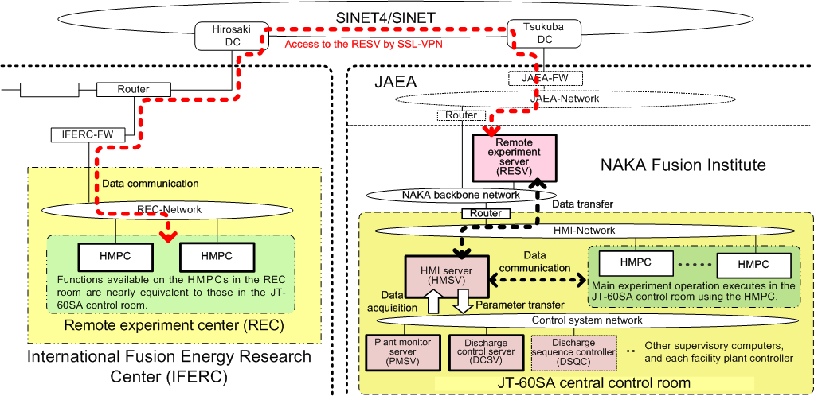
Remote experiment system using JT-60SA
HMPC on the remote site is the dedicated client PC, which can connect to the remote experiment server (RESV) on the on-site, using SSL-VPN through the network, such as SINET.
Using HMPC, remote participants can setup the discharge parameter, and also they can monitor the status of the operation of the tokamak machine/related facility and main plasma parameters.
Data of the parameters on the RESV is transferred to Human-machine interface server (HMSV) and used for the operation in the JT-60SA control system.
Notes:
This show the mechanism of the remote experiment system by using JT-60SA
HMPC on the remote site (left figure) is the dedicated client PC, which can connect to the remote experiment server (RESV) on the on-site (right figure), using SSL-VPN through the network, such as SINET.
Using HMPC, remote participants can setup the discharge parameter, and also they can monitor the status of the operation of the tokamak machine/related facility and main plasma parameters.
Data of the parameters on the RESV is transferred to Human-machine interface server (HMSV) and used for the operation in the JT-60SA control system.

Slide 10

Setting and validating the discharge parameter in JT-60SA
The function of HMPC becomes available by downloading the Java-Applet from the remote experiment server(RESV). Setting of the discharge parameter starts from the receiving the previous discharge file stored in RESV.
The discharge parameter can be changed for the next discharge in HMPC, and the changed parameter is transferred to RESV and the consistency to the limitation of the facility is validated.
HMPC
Remote experiment server (RESV)
Software for setting discharge parameter
(Java Applet)
Server process for setting discharge parameter
Display format Information File
Discharge parameter
and display format information
Read displaying parameter & information
Discharge Parameter File
Current discharge parameters are shown
Make display information
Page structure
Position x, y etc.
Discharge parameters are verified each time they are changed.
The user changes discharge parameters
Request for changing discharge parameters
The change is received and written to a file
Write changed discharge parameter
Read all discharge parameter
Changed discharge parameters are validated
Write validated result to the file
Updated discharge parameters are shown
Update discharge parameters
and display format information
Make display information
Read discharge parameters and display format information
HMPC (Remote site)
RESV (On-site, control system in JT-60SA)
Notes:
Important function of the remote experiment, that is Setting and validating the discharge parameter, is shown here,
The function of HMPC becomes available by downloading the Java-Applet from the remote experiment server(RESV). Setting of the discharge parameter starts from the receiving the previous discharge file stored in RESV.
The discharge parameter can be changed for the next discharge in HMPC, and the changed parameter is transferred to RESV and the consistency to the limitation of the facility is validated.

Slide 11
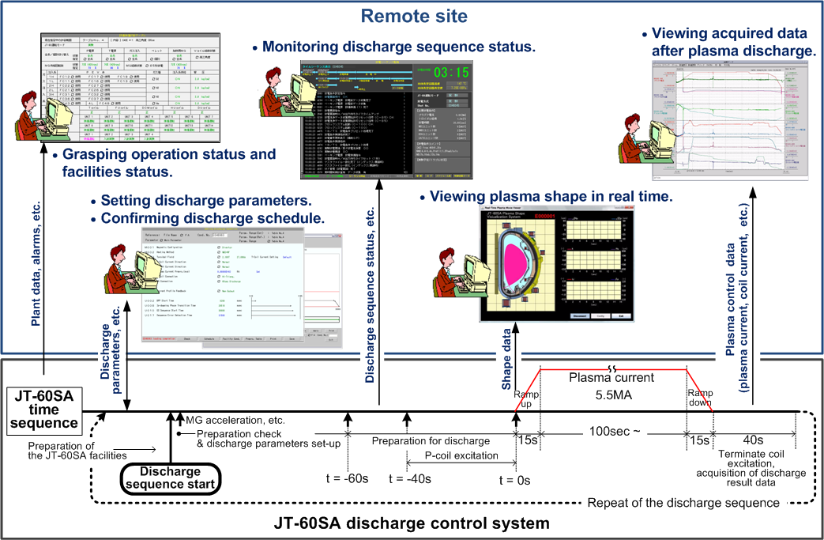
Sequence of setting and monitoring the discharge
Remote site
On-site
In accordance with the sequence of JT-60SA control system, the remote site can receive the plant status, set the discharge parameters, monitor the discharge sequence and plasma parameter in real time, and view acquired data after the plasma discharge. Development of the above software is going on.
Notes:
Sequence of setting and monitoring the discharge is shown here.
In accordance with the sequence of JT-60SA control system, the remote site can receive the plant status, set the discharge parameters, monitor the discharge sequence and plasma parameter in real time, and view acquired data after the plasma discharge.
Development of the above software is going on.

Slide 12
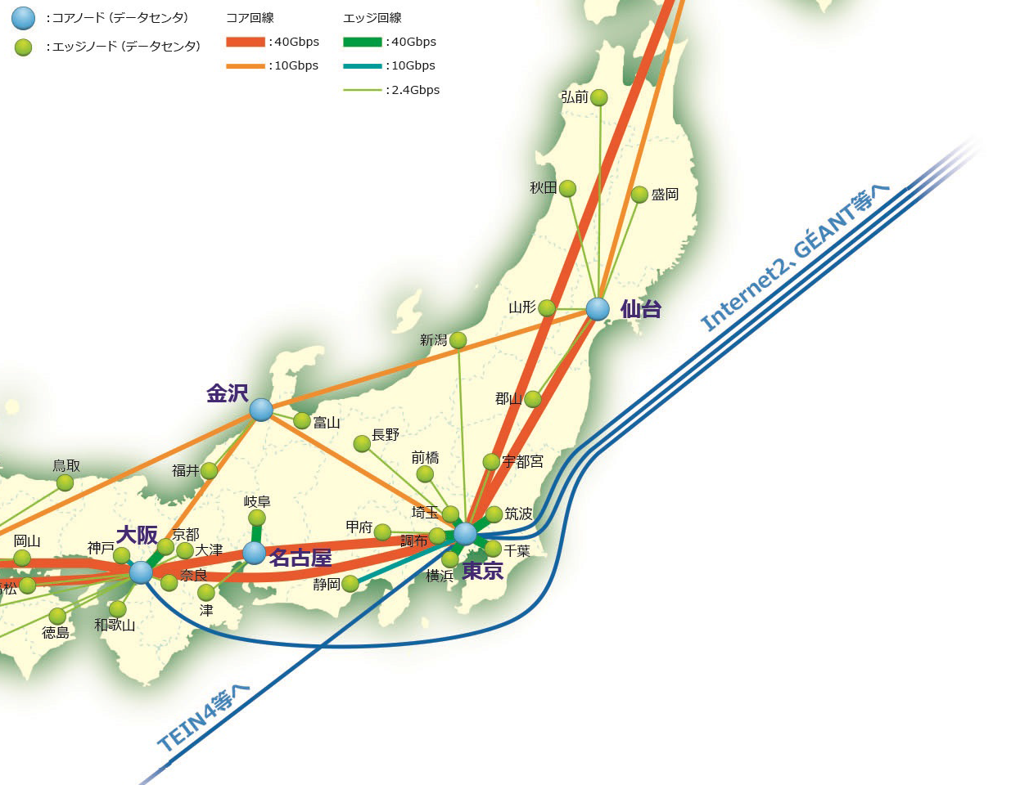
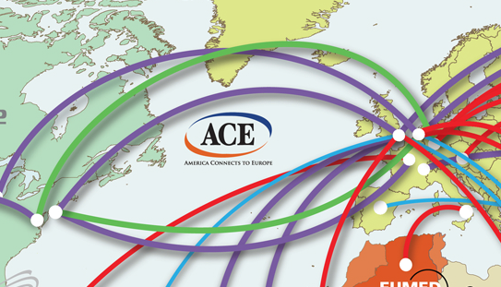
Network system for REC (Task 2)
The network system is the crucial issue for the remote experiment system.
The broad band network from Rokkaho, SINET Japan to GEANT EU was established with the collaboration with National Institute of Informatics (NII) as follows:
  10 Gbps link (SINET 4) has been established between Rokkasho and Tokyo, and also between Osaka DC of SINET 4 and Geneva of GEANT with 10 Gbps link, via Washington (US) DC of SINET 4 .
The network system in Rokkasho site will be produced to test and demonstrate the remote experiment with JT-60SA and EU tokamak, and to test the fast data transfer of the large experiment data, using the port of the L2VPN connection.
Rokkasho
GEANT
Geneva
Tokyo
Washington DC
SINET
Notes:
The network system is the crucial issue for the remote experiment system.
The broad band network from Rokkaho, SINET Japan to GEANT EU was established with the collaboration with National Institute of Informatics (NII) as follows:
10 Gbps link (SINET 4) has been established between Rokkasho and Tokyo, and also between Osaka DC of SINET 4 and Geneva of GEANT with 10 Gbps link, via Washington (US) DC of SINET 4 .
The network system in Rokkasho site will be produced to test and demonstrate the remote experiment with JT-60SA and EU tokamak, and to test the fast data transfer of the large experiment data, using the port of the L2VPN connection.

Slide 13
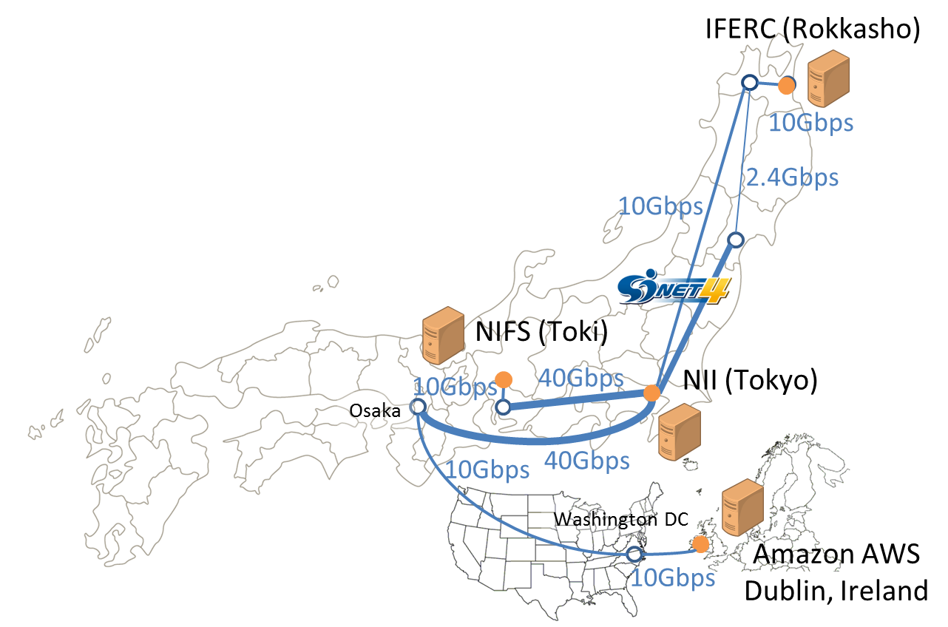
Investigation of the fast data transfer (Task 3)
The fast data transfer method is also the crucial issue for the remote experiment system.
Because TCP has a limitation on performance when it is used for data transfer over long distance network, we need efficient methods to transfer huge data between ITER and IFERC.
Our target speeds between ITER and IFERC are the following:
- Over 8 Gbps until BA end (2017),
- Over 80 Gbps until ITER start (2020).
Two methods are evaluated in network in the figure.
Pacing method
MMCFTP
Results up on now are shown in the table.
Details will be presented in the session on Friday.
[K.Yamanaka, Long distance fast data transfer experiments for the ITER Remote Experiment, 8:30PM, April 24]
From | To | RTT | Goodput
NIFS | NII | 17ms | 8.05 Gbps | Memory to Memory
NIFS | Amazon | 276ms | 2.56 Gbps | Disk to Memory
NII | Amazon | 271ms | 2.42 Gbps | Disk to Memory
Notes:
The fast data transfer method is also the crucial issue for the remote experiment system.
Because TCP has a limitation on performance when it is used for data transfer over long distance network, we need efficient methods to transfer huge data between ITER and IFERC.
Our target speeds between ITER and IFERC are the following:
- Over 8 Gbps until BA end (2017),
- Over 80 Gbps until ITER start (2020).
Two methods are evaluated in network in the figure.
Pacing method
MMCFTP
Results up on now are shown in the table.
Details will be presented by Yamanaka-san in the first session on Friday.
Don’t miss this presentation.

Slide 14
Experimental Data Analysis Software (EDAS) (Task 7)
The software of the experimental data analysis is being developed.
To participate to JT-60SA experimental data analysis from on-site and remote site in the same way, the following functions will be available;
Identical access regardless of their geographic proximity to device’s physical location
Equivalent functionality with as equivalent efficiency as possible to all participating researchers
Same remote data retrieval of local and remote APIs
3 basic tools in EDAS:
Waveform visualizer
( eGis )
(2) Plasma boundary & equilibrium viewer
( eSurf )
(3) Spatial profile analyzer
( eSlice )
Notes:
The software of the experimental data analysis is being developed as the task 7.
To participate to JT-60SA experimental data analysis from on-site and remote site in the same way, the following functions will be available;
Identical access regardless of their geographic proximity to device’s physical location
Equivalent functionality with as equivalent efficiency as possible to all participating researchers
Same remote data retrieval of local and remote APIs
3 basic tools in EDAS are being developted
Waveform visualizer( eGis )
(2) Plasma boundary & equilibrium viewer( eSurf )
(3) Spatial profile analyzer( eSlice )

Slide 15
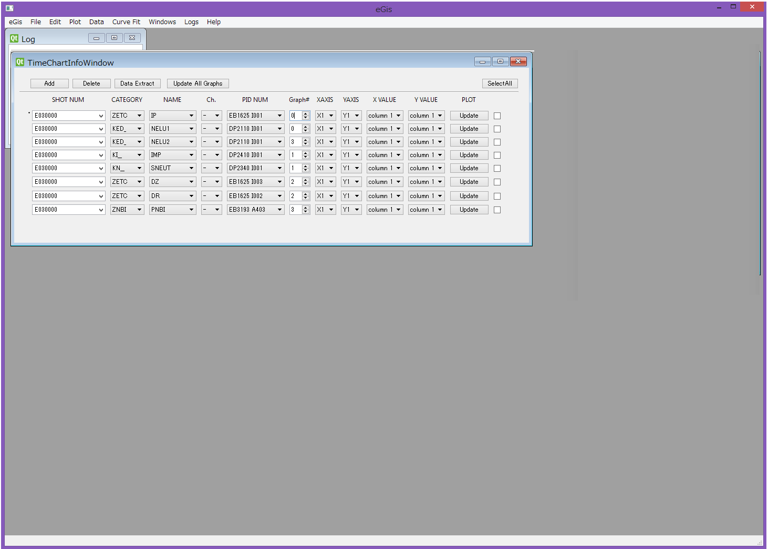
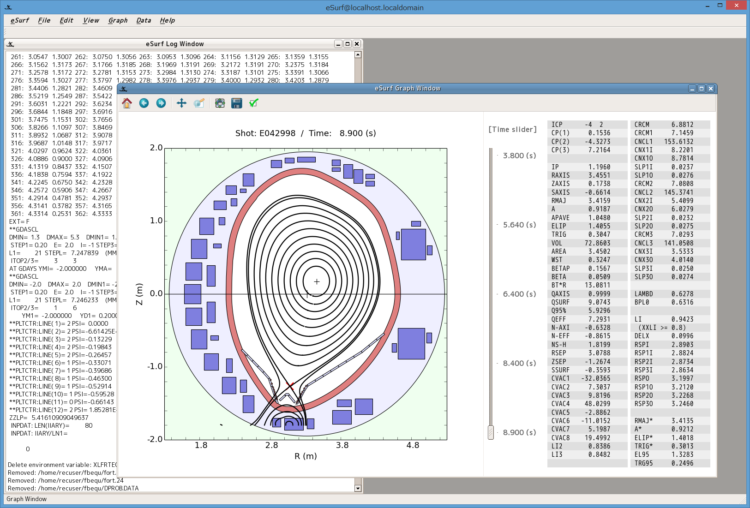
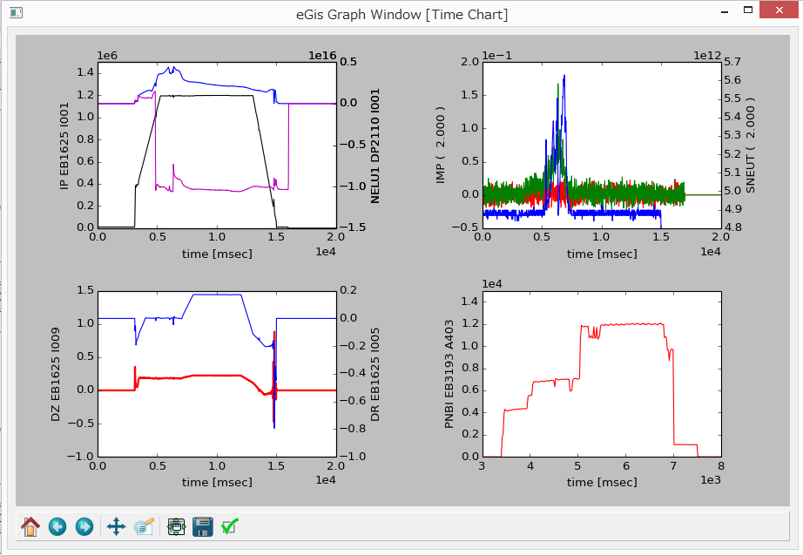
EDAS tools: eGis, eSurf, eSlice
“eGis” visualizes time dependent experimental data in discharges and also results of transport simulations.
“eSurf” visualizes plasma boundary / equilibrium together with diagnostic viewing chords and resonance locations.
“eSlice” visualizes spatial profiles from diagnostics and equilibrium. It also enables users to make 1D analysis, and to pass the saved data to a next stage of analysis or to transport code, MHD code, etc.
eGis
eSurf
Notes:
3 basic tools in EDAS are as follows;
“eGis” visualizes time dependent experimental data in discharges and also results of transport simulations.
“eSurf” visualizes plasma boundary / equilibrium together with diagnostic viewing chords and resonance locations.
“eSlice” visualizes spatial profiles from diagnostics and equilibrium. It also enables users to make 1D analysis, and to pass the saved data to a next stage of analysis or to transport code, MHD code, etc.

Slide 16
Remote Data Access (RDA) and the Integrated Software Platform for Documentation and Experiment Management (DocMs)
Development of a RDA system for the REC → Customization of MDSplus for the REC
Main objectives
Characterization of the remote data access performance between Europe and Japan
Improvement the performance of MDSplus RDA over high latency networks
Definition of metadata requirements for remote data access and integration in a data access layer built over MDSplus
Development of specific functionality in MDSplus for the data access of large signals
Definition and implementation in MDSplus of remote data streaming management for steady state experiments
Development of an integrated platform for Documentation and Experiment Management
Main objectives
Give to both local and remote users the possibility to access and manage the documentation of the remotely participated experiment (user manuals of the operational tools, signal naming, diagnostics and plant systems documentation, etc.)
Give to both local and remote users the possibility to manage the experimental workflow of the remotely participated experiments

Slide 17
Simulator (Task 8)
Tokamak simulator based on MECS code to be developed;
simulate evolution of plasma shape consistent with discharge parameters
evaluate temporal evolution of current / voltage in each PF coil
use evolution of β_{p} and l_{i} evaluated from a simple scaling or more detailed evolution imported from a plasma integrated code TOPICS
Equilibrium reconstruction (CCS)
MECS:
MHD Equilibrium Control Simulator
Sensor
Equilibrium Controller
(ISOFLUX)
PLASMA
β_{p}, l_{i}
Power
Request
temporal evolution of
I_{p}, R_{p}, Z_{p}, δ, κ …
EF6 coil
Notes:
Simulation is also important to assist the remote experiment.
The objective of this task was set to analyze plasma shots and to support decision process of shot parameters for later shots.
Tokamak simulator based on MECS code to be developed;
- To simulate evolution of plasma shape consistent with discharge parameters
- Evaluate temporal evolution of current / voltage in each PF coil
use evolution of β_{p} and l_{i} evaluated from a simple scaling or more detailed evolution imported from a plasma integrated code TOPICS

Slide 18
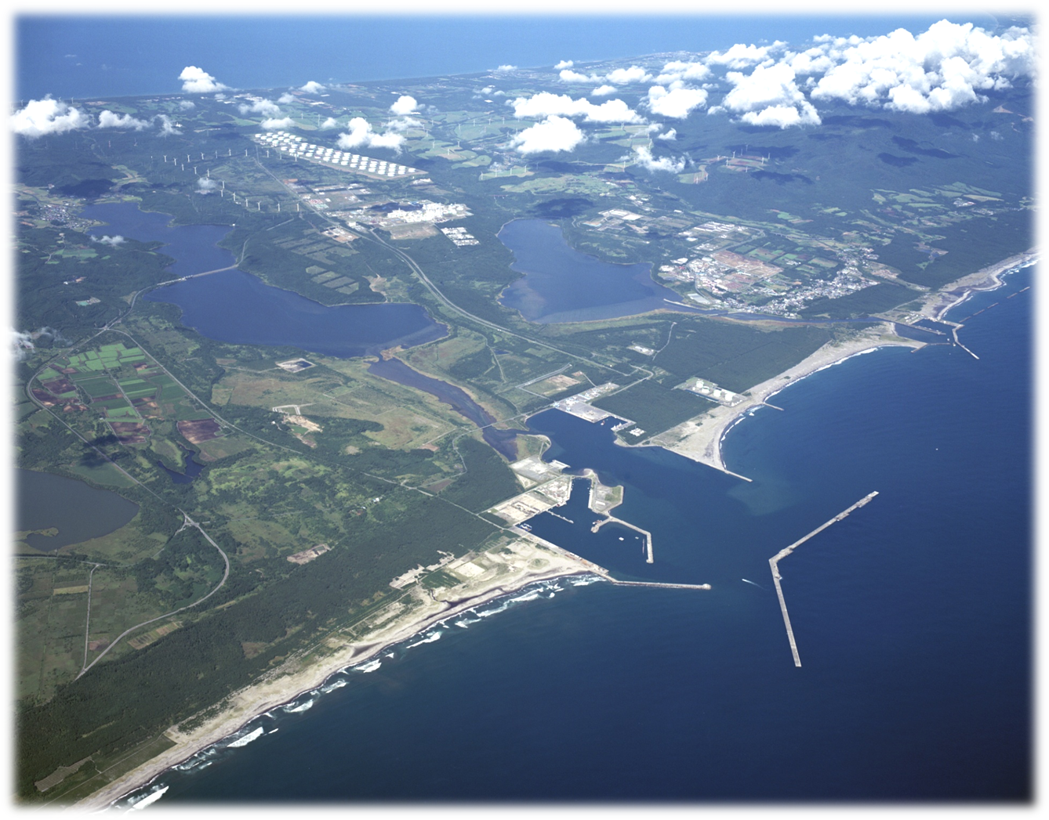
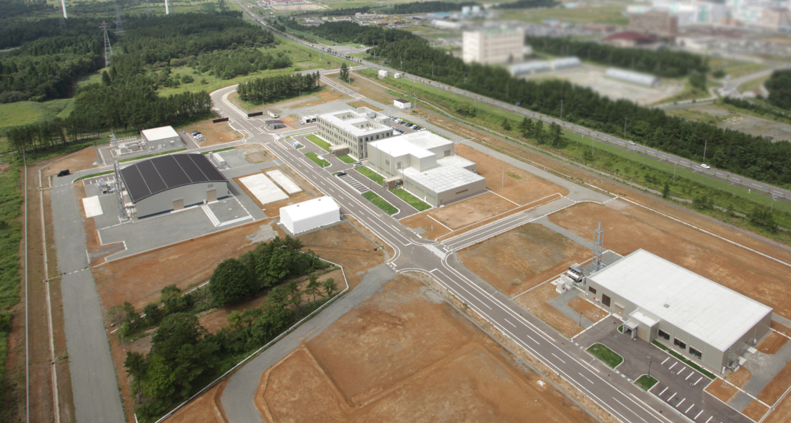
  Equipment and environment for remote experimentation system at Rokkasho site (Task 1)
Mutsu Bay
Rokkasho
Building of Remote Experimentation Centre
The Pacific Ocean
Rokkasho Fusion Research Institute of JAEA
Research buildings, including the remote experimentation center, have been made in March 2010 and utilities have been constructed during 2011 – 2012. Supercomputer of 1.2 Peta flops class is in full operation since April 2012.
      The remote experimentation centre will be made in Rokkasho that is the north area in Japan.
      Equipment and environment for the remote experimentation system will be prepared from 2015.
18
Notes:
Equipment and environment for remote experimentation system at Rokkasho site, as Task 1
This is an aerial photograph in Rokkasho area, the north area in Japan. (left figure)
The remote experimentation centre will be made in Rokkasho.
This is the Rokaksho site of JAEA. (right figure)
Research buildings, including the remote experimentation center, have been made in March 2010 and utilities have been constructed during 2011 – 2012. Supercomputer of 1.2 Peta flops class is in full operation since April 2012.
Equipment and environment for the remote experimentation system will be prepared from 2015.

Slide 19
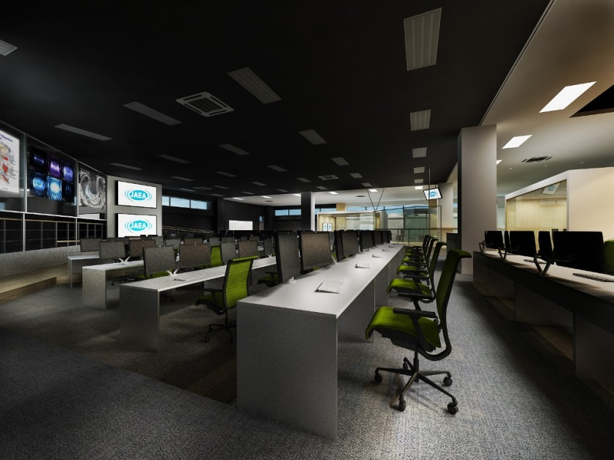
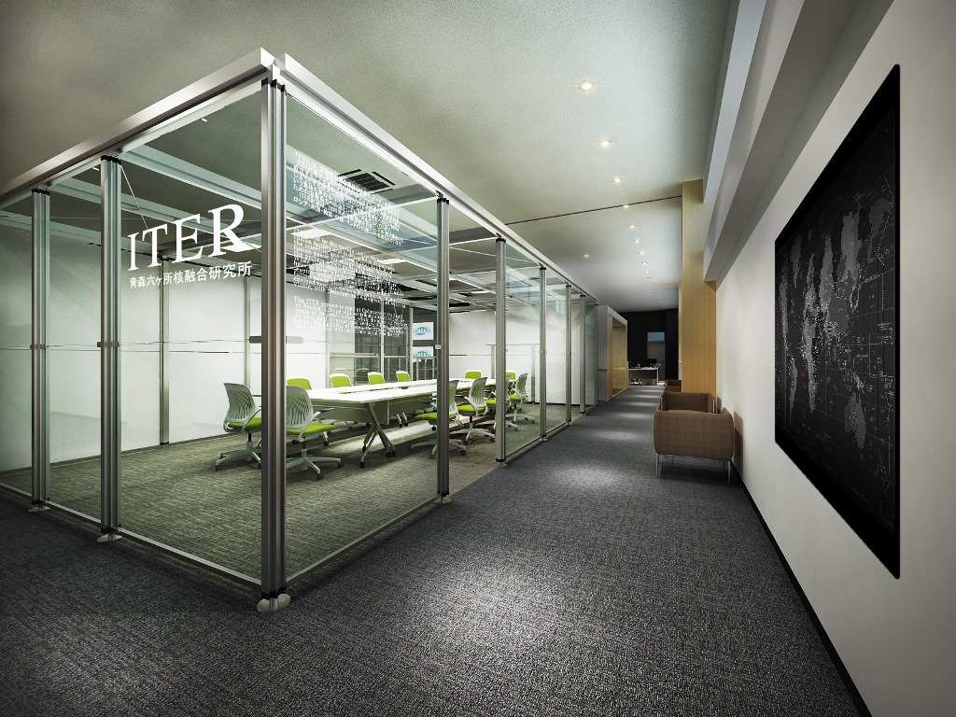
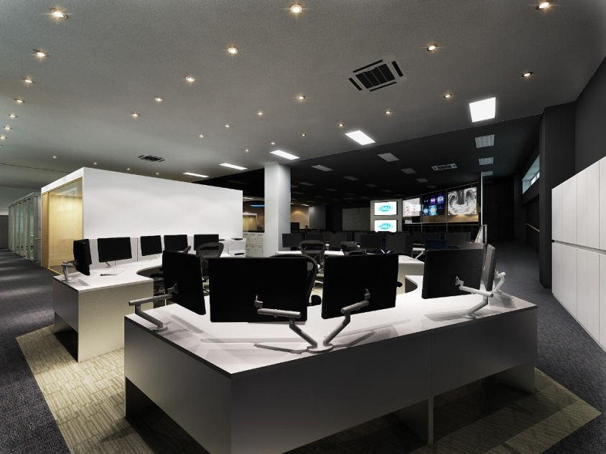
  Image of the room of remote experiment centre
The IT equipment of the PCs for RES, servers for simulation, video conference system, and large screen will be prepared for the remote experiment.
Separated rooms by appropriate zoning are also prepared to enable the various kinds of missions/ works expected for “Remote Experiment” and related works.
REC room are used for multipurpose arrangements in the main zone, such as Remote Experiment, Seminar, and Big formal meeting.
The REC room will have a position as a centre of remote collaborative activities and the information.
19
Layout and specifications of the remote experiment room to be determined.
Notes:
This is a CG image of the remote experiment centre
The IT equipment of the PCs for RES, servers for simulation, video conference system, and large screen will be prepared for the remote experiment.
Separated rooms by appropriate zoning are also prepared to enable the various kinds of missions/ works expected for “Remote Experiment” and related works.
REC room are used for multipurpose arrangements in the main zone, such as Remote Experiment, Seminar, and Big formal meeting.
The REC room will have a position as a centre of remote collaborative activities and the information.

Slide 20
Summary
To realize the remote experimentation center, eight tasks were set by the experts of EU and Japan and the specification of each task was determined.
The development of the software using the JT-60SA has been started, which includes the remote experiment system(RES), the data analysis software(EDAS), Remote Data Access (RDA) Software Framework and the Integrated Software Platform for Documentation and Experiment Management (DocMs).
The investigation of the fast data transfer method is going on.
The preparation of the network system and the equipment in the the remote experiment room in Rokkasho site will start in 2015.
The activity of the REC is on schedule. The function of REC will be tested and the operation of the total system will be demonstrated.
  Thank you for your attention.
20
Notes:
In summary,
To realize the remote experimentation center, eight tasks were set by the experts of EU and Japan and the specification of each task was determined.
The development of the software using the JT-60SA has been started, which includes the remote experiment system(RES), the data analysis software(EDAS), Remote Data Access (RDA) Software Framework and the Integrated Software Platform for Documentation and Experiment Management (DocMs).
The investigation of the fast data transfer method is going on.
The preparation of the network system and the equipment in the the remote experiment room in Rokkasho site will start in 2015.
The activity of the REC is on schedule. The function of REC will be tested and the operation of the total system will be demonstrated.
Thank you for your attention.

